Slide 1

CS341 Lab 3
EEPROM and checksum
https://github.com/whittyh/CS341

Slide 2
Lab 3 Objectives:
Use the EEPROM to save some initial data into persistent memory
Make use of EEPROM functions in Arduino
Use bitwise operators to create a simple checksum for testing validity of the data in EEPROM, is the data what we should expect or did it change?

Slide 3
EEPROM Functions:
EEPROM.read(int address);
EEPROM.write(int address, int value);
EEPROM.write(5, 0x41);
EEPROM.read(5); //returns ‘A’
EEPROM.update(int address, int value);
https://www.arduino.cc/en/Reference/EEPROM

Slide 4
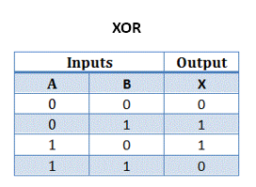
Bitwise Operators
operate on all numbers, but easiest to see how they work with binary numbers
Exclusive Or (also know as XOR)
0011₂ ^ 0101₂ = 0110₂
Logical Not (also known as compliment)
~ 0101₂ ₌ 1010₂

Slide 5
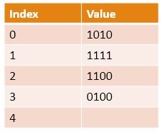
A Simple CheckSum Algorithm:
Purpose: check whether data was corrupted while downloading, transferring, etc
Works by performing an operation on some memory addresses in EEPROM and storing the result in EEPROM to compare with later (after power cycle)
CheckSum Algorithm:
1010₂ ^ 1111₂ = 0101₂
0101₂ ^ 1100₂ = 1001₂
1001₂ ^ 0100₂ = 1101₂
~1101₂ = 0010₂

